Slide 1
HOW TO WRITE & EXECUTE AN ASSEMBLY LANGUAGE PROGRAM

Slide 2
8085 Assembly Language Programming -RECAP
8085 Hardware model
8085 Programming model
Flag Register
Opcode and operand
Instruction set
Addressing mode
Logical steps to solve a simple programming problem

Slide 3
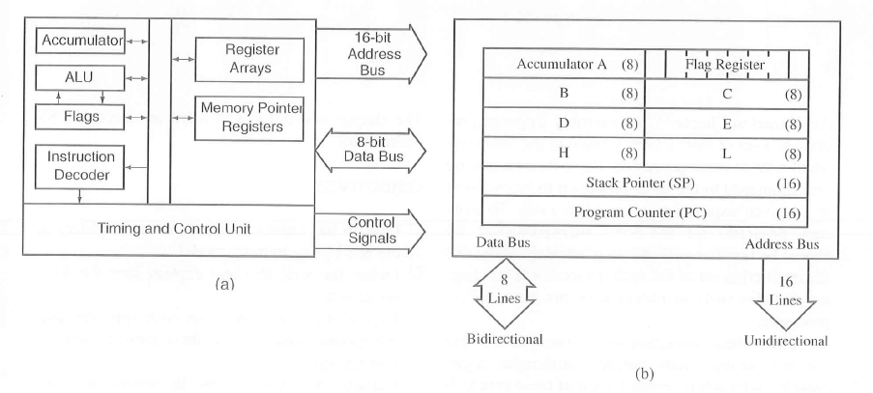
8085 Hardware & Programming model
A model is a conceptual representation of a real object.
A Microprocessor can be represented in terms of its hardware (physical electronics components)
and a programming model(information needed to write programs).

Slide 4
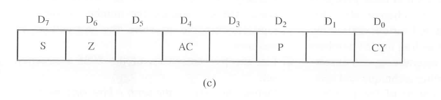

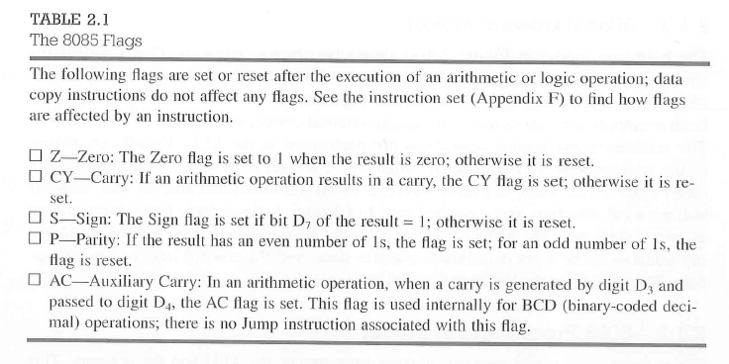

Slide 5
The 8085 instruction set- RECAP
Data transfer instructions
Arithmetic instructions
Logical instructions
Branching instructions and
Control instructions.

Slide 6
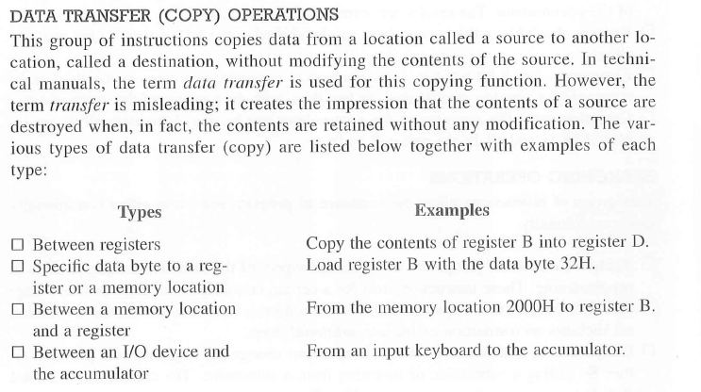
1. Data transfer instructions

Slide 7
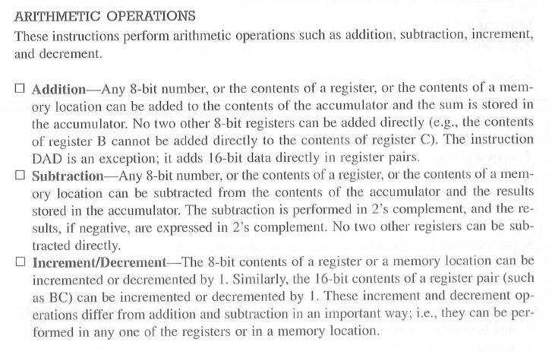
2. Arithmetic instructions

Slide 8
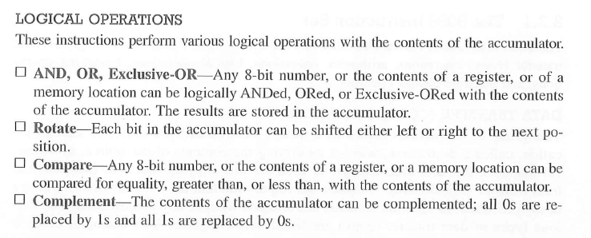
3. Logical instructions

Slide 9
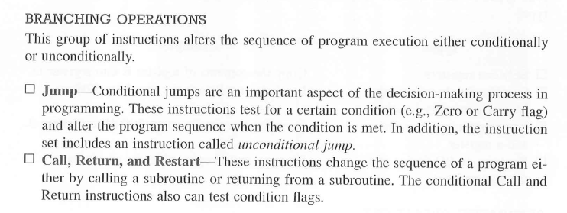
4. Branching instructions

Slide 10
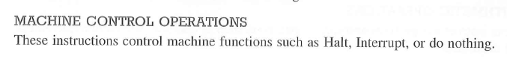
5. Control instructions.

Slide 11
INSTRUCTION, DATA FORMAT & STORAGE
It is a command that can make the microprocessor perform a specific function.
An Instruction is basically a combination of two parts one is operation code and the next is operands
The opcode will be used to identify what kind of operation needs to be performed.
Operands will be used to spot the source and destination

Slide 12
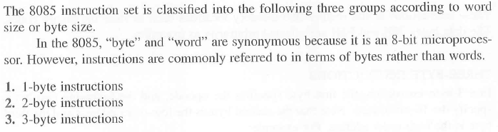
INSTRUCTION WORD SIZE

Slide 13
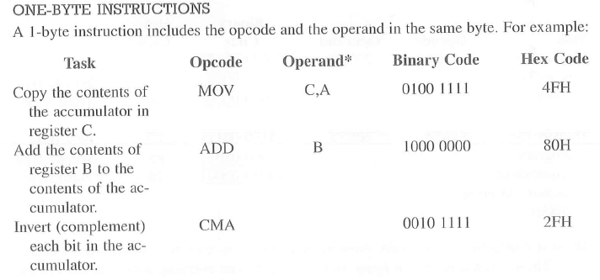
ONE BYTE INSTRUCTIONS

Slide 14
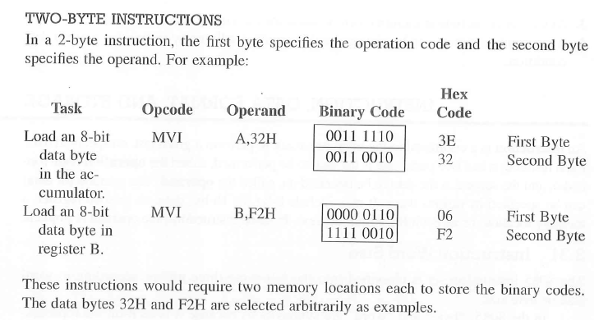
TWO BYTE INSTRUCTIONS

Slide 15
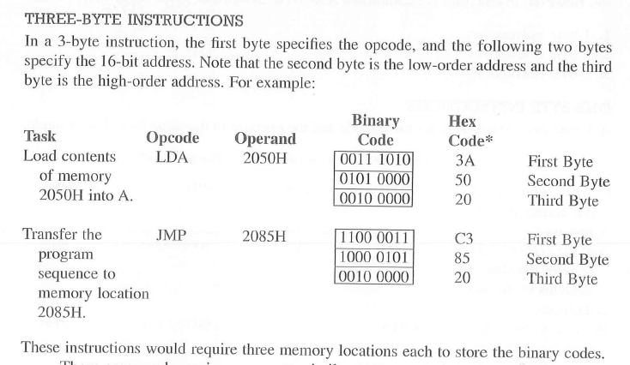
THREE BYTE INSTRUCTIONS

Slide 16
ADDRESSING MODES- RECAP
8085 supports five types of addressing:
The addressing modes are
Immediate Addressing
Direct Addressing
Register Addressing
Register Indirect Addressing
Implicit Addressing

Slide 17
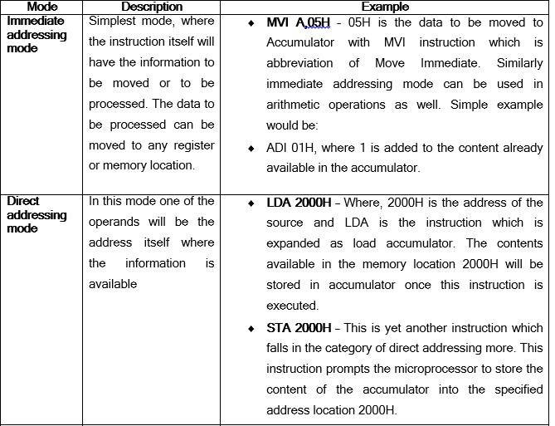

Slide 18
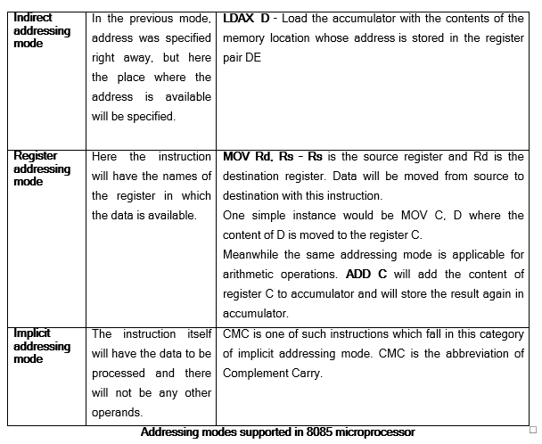

Slide 19
ADRESSING MODE
Pass the butter( Direct value)
Pass the bowl (Content in that)
Let us eat (Assuming, one knows what to eat)
I will have combination 17 on the menu (location of the item on the menu specified)
I will have what Susie ordered
Immediate Addressing mode
Register Addressing mode
Implicit Addressing mode
Direct Addressing mode
Indirect Addressing mode

Slide 20
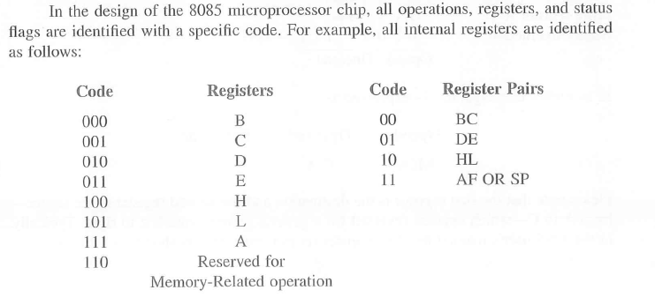
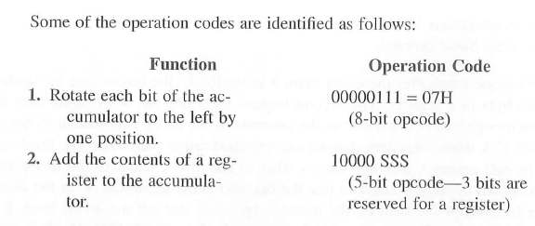
OPCODE FORMAT

Slide 21
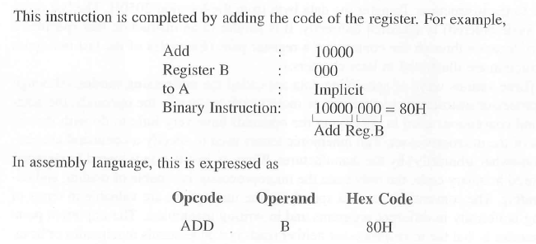
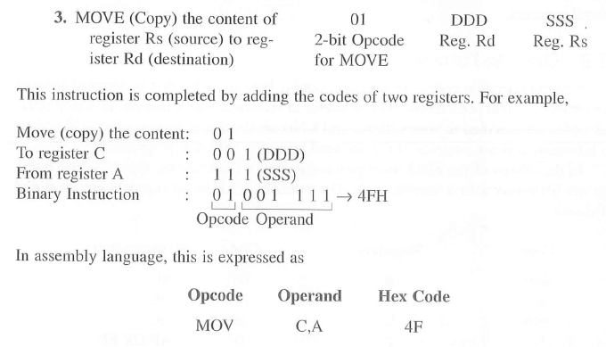

Slide 22
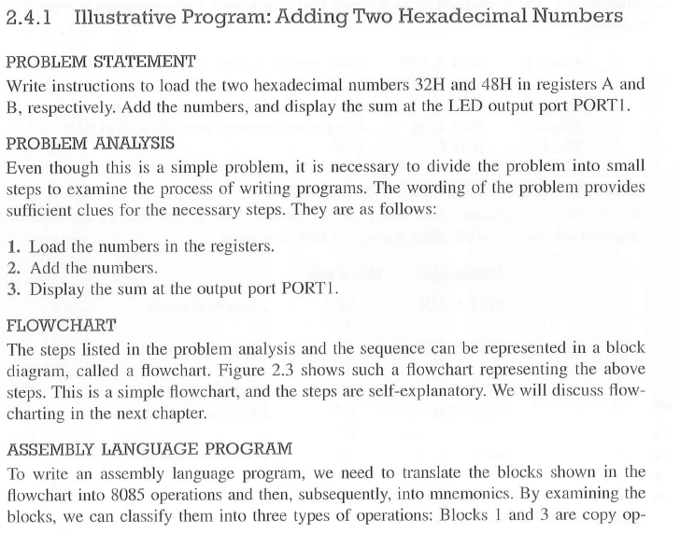
HOW TO WRITE, ASSSEMBLE AND EXECUTE A SIMPLE PROGRAM

Slide 23
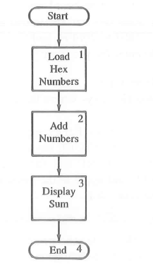
Flow chart

Slide 24
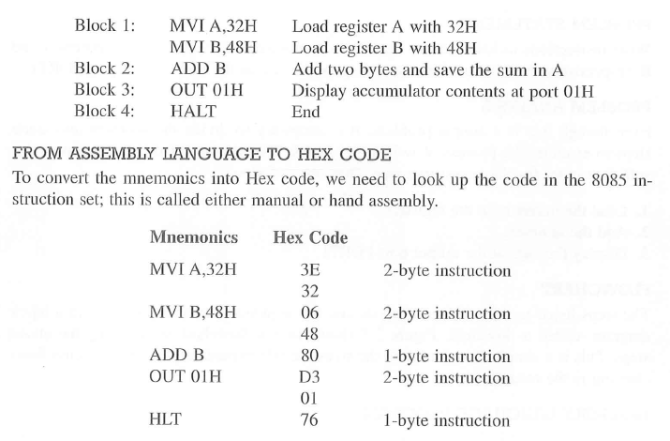
Assembly Language Program

Slide 25
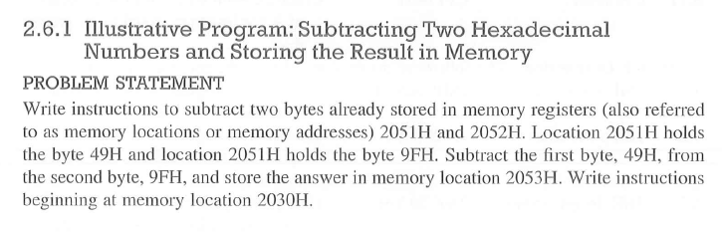
WRITING & HAND ASSEMBLING A PROGRAM

Slide 26
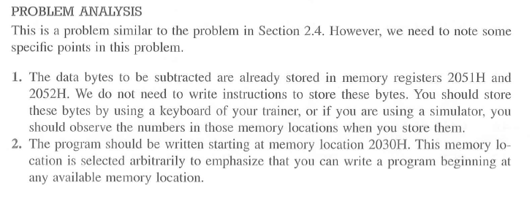
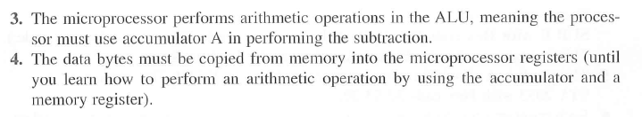

Slide 27
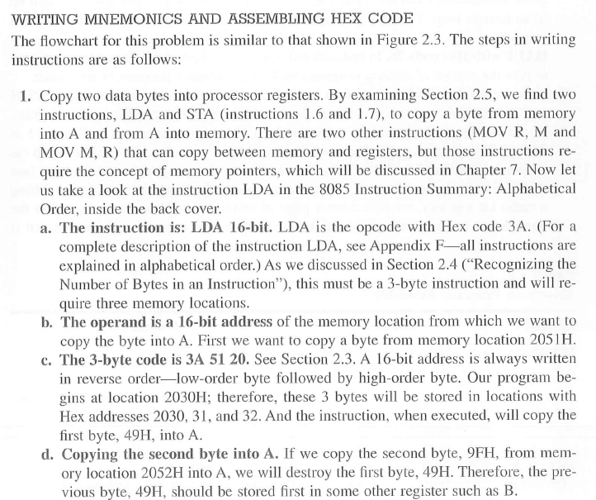

Slide 28
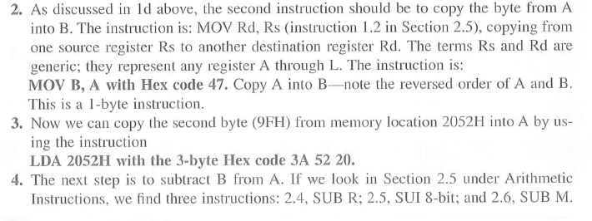
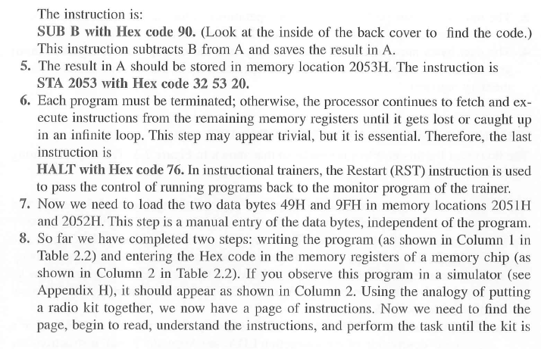

Slide 29
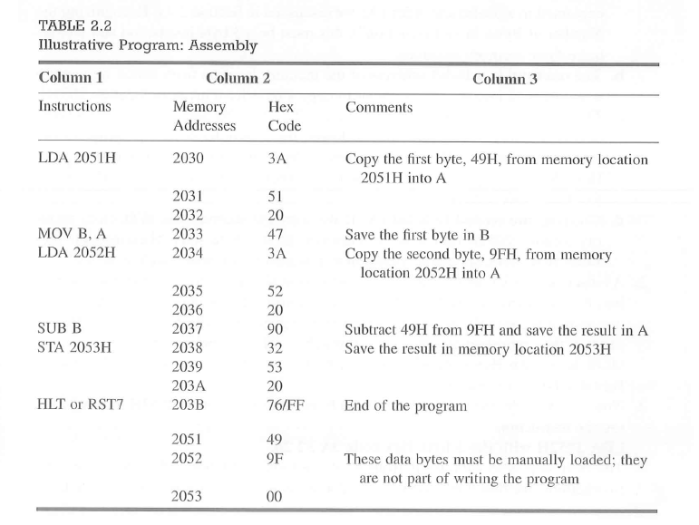

Slide 30
How up executes an instruction?

Slide 31
ASSEMBLY INSTRUCTION:
LDA 4200
MVI B,78H
ADD B
STA 4500H
HLT
MEMORY
2000 | 3A
2001 | 00
2002 | 42
2003 | 06
2004 | 78
2005 | 80
2006 | 32
2007 | 00
2008 | 45
2009 | 76
200A
4200 | 01h
4500 | 79h
MACHINE CODE:
2000 3A LDA 4200
2001 00
2002 42
2003 06 MVI B,78H
2004 78
2005 80 ADD B
2006 32 STA 4500H
2007 00
2008 45
2009 76 HLT
200A

Slide 32
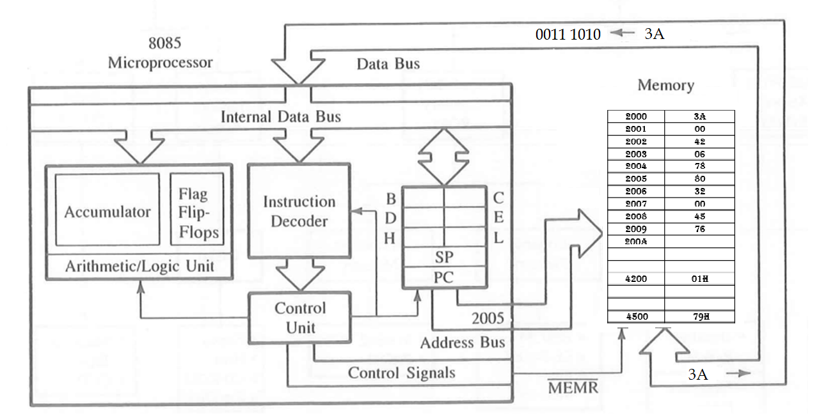
OPCODE FETCH

Slide 33
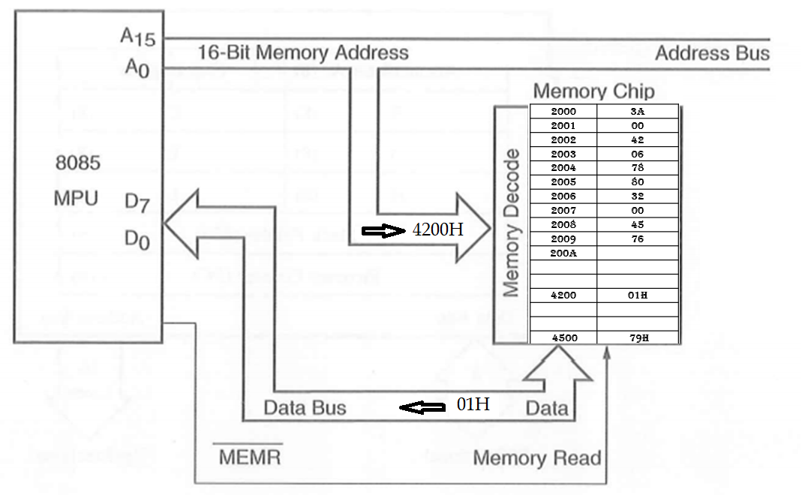
MEMORY READ

Slide 34

MEMORY WRITE

Slide 35
Thank You
Reference: Chapter 2, Ramesh Gaonkar, 8085 Microprocessor Architecture Programming and applications with the 8085

